Slide 1
LinkedIn Freshers
Design Sprint
Product Manager: Debdeep Bandyopadhyay
© 2019 Udacity. All rights reserved.

Slide 2
Set the stage
Set the stage for the Design Sprint by framing the problem
© 2019 Udacity. All rights reserved.
Notes:
[ALL PARTICIPATION]

Slide 3

Initial PRD
Link your PRD

Slide 4
Understand
Create a shared understanding of the space, problem, and goals
© 2019 Udacity. All rights reserved.
Notes:
[ALL PARTICIPATION]

Slide 5
How Might We
How might we provide contructive feedback based on resume
How might we connect users to mentors
How might we nurture new grads for new job
How might we connect users with right mentors
How might we make the resume filling process more interesting
How might we upskill users
How might we recommend more things to users
How might we attract more new grads to platofrm
How might we suggest courses based on resume.
How might we design career path for users
How might we establish interaction btw
Users and companies
How might we provide resume writing assistance
How might we onboard more and more companies
How might we add important keywords and phrases to resume.
How might we recommend jobs to users
How might we upskill users
How might we reduce job application time
How might we find the kind of job a graduate is searching for
How might we prep users to crack interview
How to add more courses to platform based on user needs
How might we map users to jobs based on resume
How might we suggest career path based on goals/interest

Slide 6
Other stickies 1
How might we help users evaluate job vs grad school?
How might we evaluate employer profile effectiveness?
How might we protect user information?
How might we find recent college grads?
How might we match skills with employer needs?
How might we share reviews about employers?
How might we provide resume writing assistance?
How might we evaluate user profile effectiveness?
How might we improve user profile quality?
How might we facilitate communication between user and employers?
How might we get college graduates to want to learn about jobs
How might we help grads assess job fit?
How might we help colleges grads learn what jobs are really like?
How might we figure out living wage in a geographic area?
How might we help college grads prioritize their interests?
How might we assess a user's job preferences?
How might we capture a user's work style?
How might we figure out if a person is looking for a job?
How might we find job openings for college grads?
How might we evaluate the quality of a job?

Slide 7
Other stickies 2
How might we connect users with mentors?
How might we give incentives to get friends using the app?
How might we create a supportive social network for job seekers?
How might we create an accurate and reliable recommendation engine?
How might we create accurate matches?
How might we help colleges grads calibrate their skills?
How might we connect users from the same schools?
How might we partner with college career centers?
How might we create a model and account for bias in our model and job areas?
How might we get accurate and timely job market information?
How might we help college grads identify their preferences?
How might we assess a user's job skills?
How might we assess geographic preferences?
How might we build a reliable data pipeline?
How might we use the data we already have on users?
How might we leverage existing technologies?
How might we develop partnership with schools?
How might we request information from companies?
How might we incentivize students to use the new app?
How might we choose when is the right time to have students participate?

Slide 8
Other stickies 3
How might we market our app to users?
How might we allow students to discover their passions?
How might improve connection recommendations based on candidate’s interest?
How might we incentivize our paid subscriptions models?
How might we gather user feedback?
How might we help students align their passions to available jobs?
How might we suggest Job events/conference/fairs based on candidate’s interest?
How might we improve the salary projections for roles specific to the industry/location/experience?
How might we improve user satisfaction?
How might we motivate students to apply to jobs based on their interests?
How might we recommend professional certifications, courses, conferences to employees?
How might we improve job recommendations to users?
How might we help students become more aware of jobs available to them?
How might we build and improve professional mentorship community?

Slide 9
Help Users Land a Job
How might we help college grads identify their preferences?
How might we build and improve professional mentorship community?
How might we upskill users?
How might we connect users with mentors?
How might we find mentors for interview prep?
How might we assess geographic preferences?
How might we capture a user's work style?
How might we figure out living wage in a geographic area?
How might we help colleges grads calibrate their skills?
How might we recommend professional certifications, courses, conferences to employees?
How might we find mentor for skill prep?
How might we assess a user's job skills?
How might we help grads assess job fit?
How might we help colleges grads learn what jobs are really like?
How might we make users on landing job nurture new users?
How might we prep users for interviews?
How might we help colleges grads learn what jobs are really like?
Upskill and prepare for interviews/tests
Priority needs

Slide 10
Improving Product
How might we facilitate communication between user and employers?
How might we improve the salary projections for roles specific to the industry/location/experience?
How might we incentivize our paid subscriptions models?
How might we create accurate matches?
How might we build a reliable data pipeline?
How might we share reviews about employers?
How might we provide feedback on rejections?
How might we reduce job application time?
How might we model company needs for users to understand?
How might we market our app to users?
How might we gather user feedback?
How might we get accurate and timely job market information?
How might we evaluate employer profile effectiveness?
How might we give incentives to get friends using the app?
How might we evaluate the quality of a job?
How might we find job openings for college grads?
How might we create more synergy with existing products?
How might we protect user information?
How might we make interaction between user and company intuitive?
How might we match skills with employer needs?
How might we improve user satisfaction?
How might we request information from companies?
How might we leverage existing technologies?
How might we create a model and account for bias in our model and job areas?
How might we use the data we already have on users?
How might we create an accurate and reliable recommendation engine?
Develop tech and data capabilities based on existing users
Collaborate with companies for better user experience

Slide 11
Find and Engage Users
How might we motivate students to apply to jobs based on their interests?
How might improve connection recommendations based on candidate’s interest?
How might we connect with users even before they graduate?
How might we get college graduates to want to learn about jobs
How might we improve job recommendations to users?
How might we help users evaluate job vs grad school?
How might we make the resume filling process more intuitive?
How might we provide feedback to resume/profile creation?
How might we design career path?
How might we partner with college career centers?
How might we suggest Job events/conference/fairs based on candidate’s interest?
How might we allow students to discover their passions?
How might we understand user goals and interests?
How might we provide content based on goals/interests/skills?
How might we provide resume writing assistance?
How might we suggest career path based on goals/interests/skills?
How might we evaluate user profile effectiveness?
How might we improve user profile quality?
How might we assess a user's job preferences?
How might we help college grads prioritize their interests?
How might we find recent college grads?
How might we recommend more things to users?
How might we choose when is the right time to have students participate?
How might we connect users to similar users?
How might we develop partnership with schools?
How might we help students become more aware of jobs available to them?
How might we search jobs that match user goals/interests/skills?
How might we help students align their passions to available jobs?
How might we figure out if a person is looking for a job?
Help users create and improve profile
Recommend contents based on goals/ interests
Onboard more users

Slide 12
Others
How might we Protect user information
How might we connect users from the same schools?
How might we partner with college career centers?
How might we create a supportive social network of students
How might we incentivize students to use the new app?
Connect same school/colege users
Feedback and marketing
Data Governance

Slide 13
Sprint Focus
Focus | Help Users Land a Job
Slide # | #9
I selected this theme because | Primary goal of the product is to help new graduates upskill and find a job. Basic priority is to understand user preferences and gain feedback. Also initially many models need to be trained so we need proper user engagement for optimizing the product.

Slide 14
Define
With an understanding of the problem space, create focus and align on specific outcomes for the Design Sprint
© 2019 Udacity. All rights reserved.
Notes:
[ALL PARTICIPATION]

Slide 15
Success Metrics
 | Goals | Signals | Metrics
Happiness | User lands in dream job User upskills himself through linkedin learning User gains confidence | New job search after landing a job through linkedin | Email surveys and feedback
Engagement | Applies to job User engages with the platform | Search job Update profile Explore companies Explore contents | Job searches/month Profile updates/ month
Adoption | Share job listing with friends Onboard more universities on platform | Referrals by friends/ universities | Referral rate Referral onboard rate Job posting rate
Retention | Users on landing job becomes mentors New upskilling programs and mentors | Applyting for upskiling Applying for mentor | Programs enrolled Time spent Mentors selected
Task Success | Find relevant jobs easily Land jobs faster | Users applies to job | Application rate

Slide 16
LinkedIn Freshers ( Sneak Peak)
LinkedIn’s new product for college students and new graduates, called LinkedIn Freshers is going to launch in the main app very soon
It is going to be a one-stop solution for guiding inexperienced students and graduates right from resume creation to landing jobs without feeling underwhelmed at any point.
The initial launch will feature a resume creation bot, an interview preparation and upskilling bot, a mentor recommendation option and a first-of-a-kind feature to find out how well a candidates’ goals and interests aligns with the company.
The biggest issues, as pointed out by many new graduates, are the low confidence, lack of understanding of roles in company, lack of good mentors which often leaves them confused
Initial reviews of the features have found the LinkedIn’s new launch a great boon, with features like interest understanding, interview prep and upskilling modules, LinkedIn’s new launch is going to make navigating the job market a breeze for the millenials

Slide 17
Sketch
Generate tons of ideas, then narrow them down to two in depth solution sketches
© 2019 Udacity. All rights reserved.
Notes:
[ALL PARTICIPATION]

Slide 18
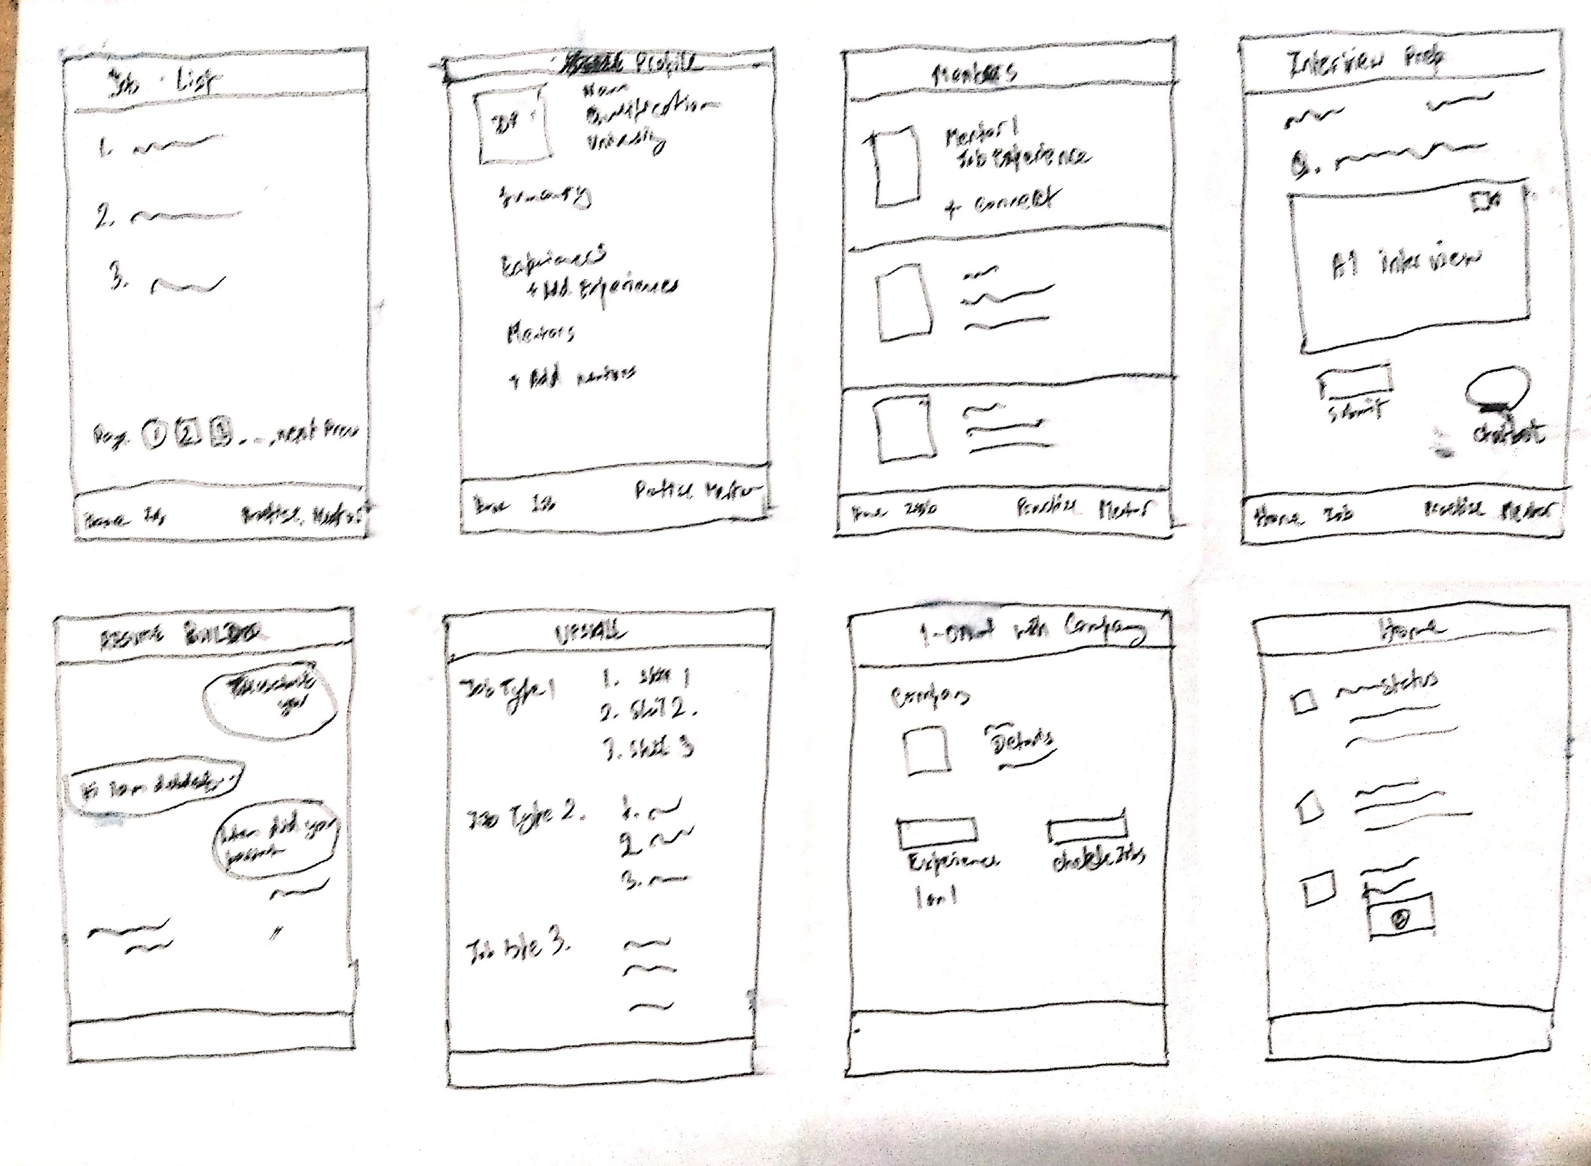
8 Sketches
Photo of your 8 sketches here

Slide 19
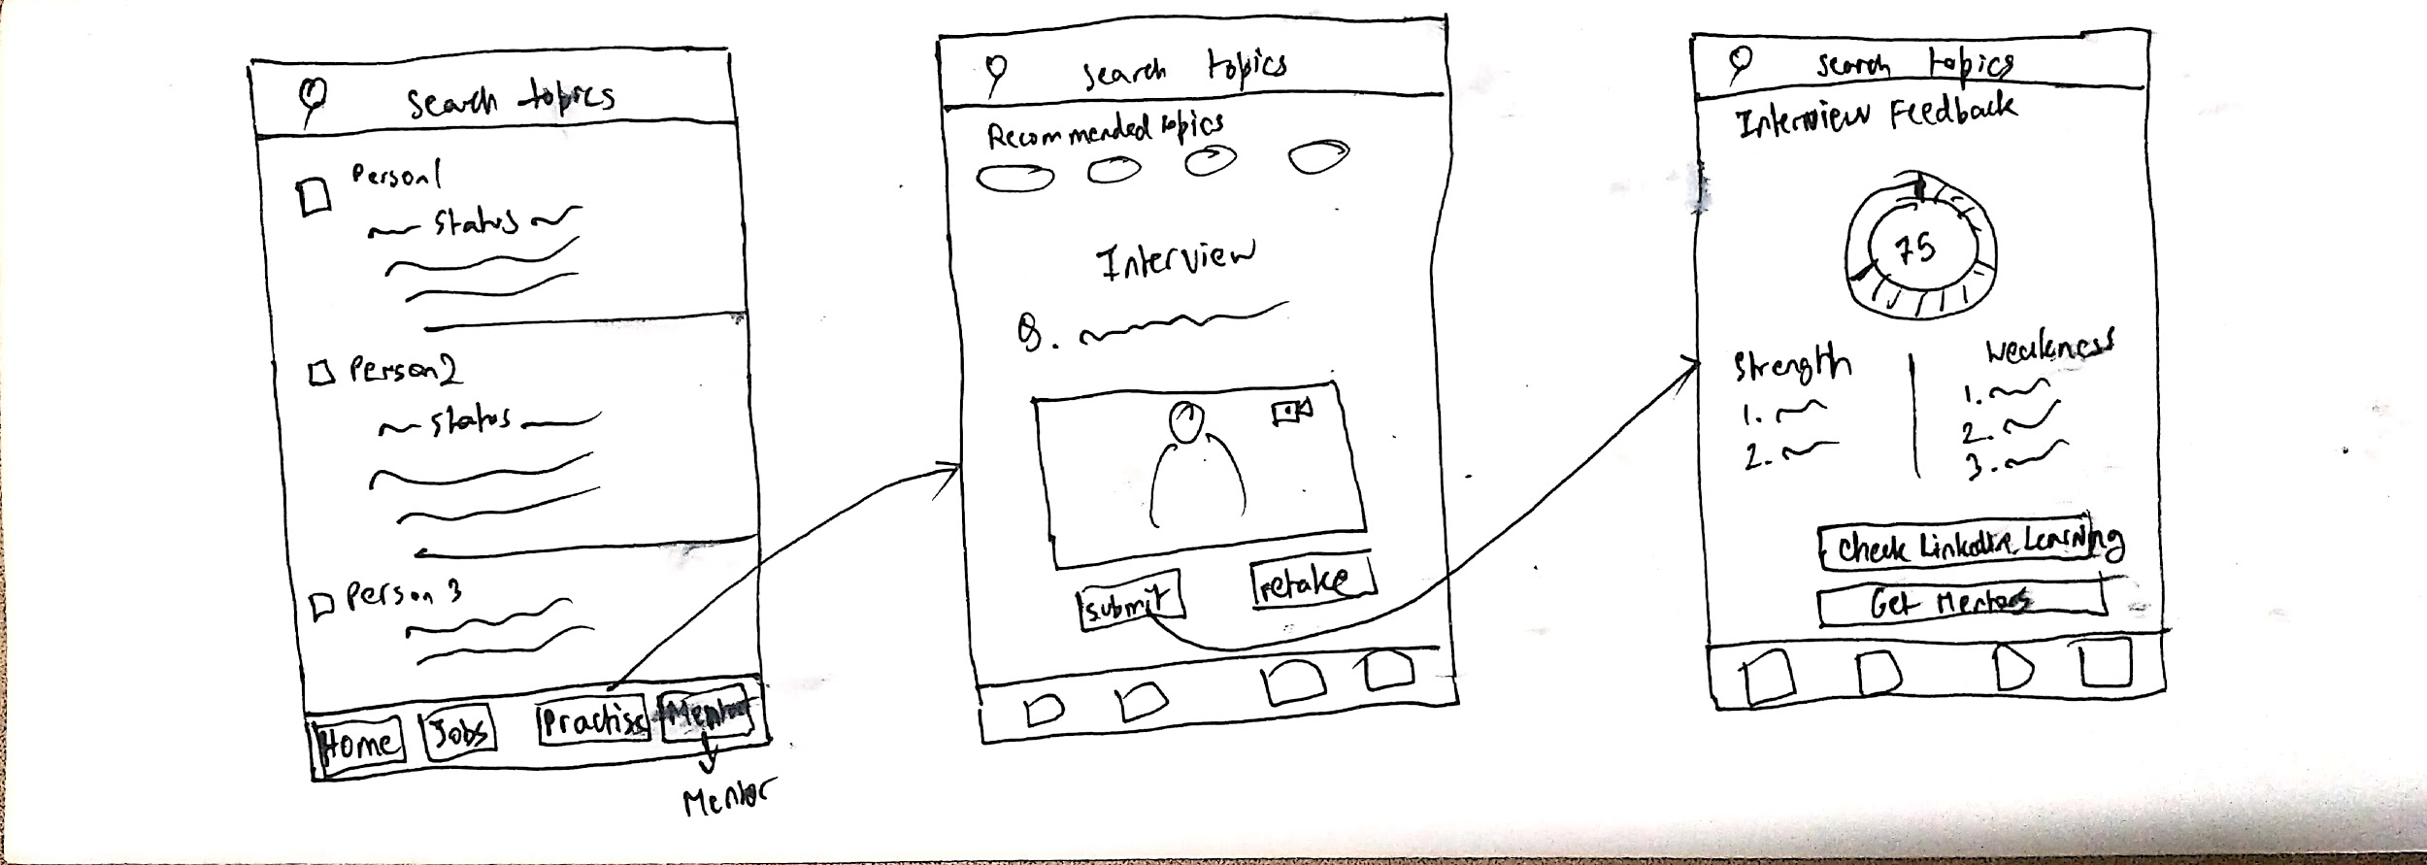
Solution Sketch 1: Interview Module
Upload a photo of your sketch on this slide

Slide 20
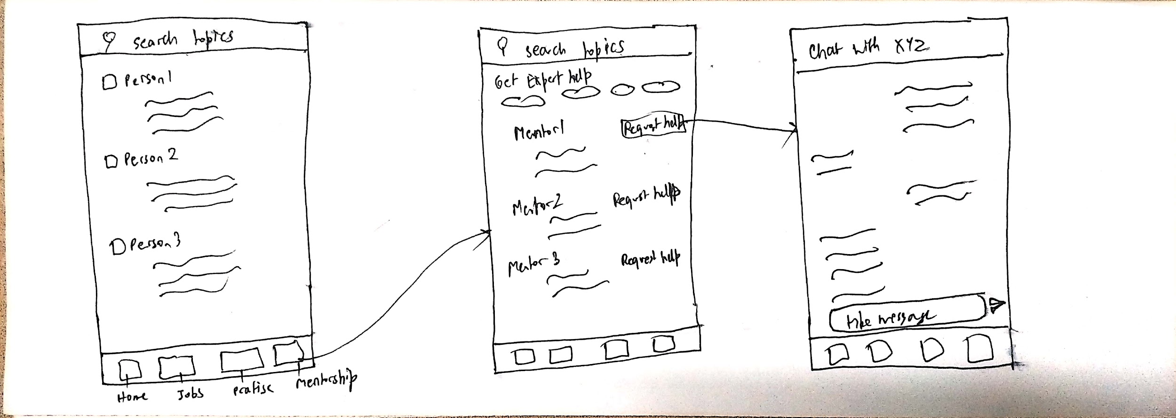
Solution Sketch 2 : Mentorship Module
Upload a photo of your sketch on this slide

Slide 21
Decide
Pick the final concept that you develop into a prototype
© 2019 Udacity. All rights reserved.
Notes:
[ALL PARTICIPATION]

Slide 22
Decision
Decision | Interview Module
Rationale | Our initial priority is to help users land in a job and so main criteria to land in a job is to crack the interview first. To help users face the interview with confidence and positivity we will be focussing in the interview module.

Slide 23
Prototype
Turn your concept into a realistic, interactive prototype that you will use to validate your assumptions and ideas
© 2019 Udacity. All rights reserved.
Notes:
[ALL PARTICIPATION]

Slide 24

Storyboard
Link your plot
Link for the project has been provided in google file document

Slide 25
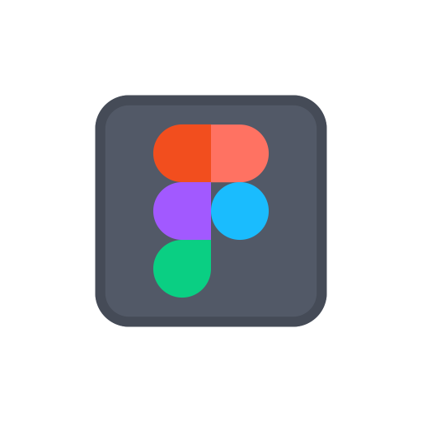
Prototype
Description High level overview of the prototype What does it do? | This prototype helps user to find recommended jobs, helps user with interview preparation and seek help from experts.
Assumptions Any assumptions within the prototype | Users are familiar with linkedin platform. Users will be able to navigate in the platform Users have to initiate a conversation with mentors
Tasks What are the tasks that a user can complete in the prototype? | Users can find various resources such as recommended courses from linkedin learning, recommended jobs , mock interviews , questions and mock tests etc. Users can find recommended mentors and initiate conversation with them in messenger.
Link your prototype

Slide 26
Validate
Users will go through your prototype and provide feedback on your concept. This is also an opportunity to have an engineering feasibility discussion
© 2019 Udacity. All rights reserved.
Notes:
[ALL PARTICIPATION]

Slide 27
Plan and recruit for research
Link your research plan

Slide 28

User Testing
Link your
notes
Link your audio recording
Key Findings from Participant 1
What worked well | He was able to explore the various product features. He was very interested in the product and its offerings. He had quite a lot of suggestions for product improvement,
Where participants got stuck | He slightly got struck to start a conversation with mentor.
Other observations | He was concerned about the data privacy and how was the interview video stored. He was also concerned whether the AI based interviewer can be as efficient as human interviewer considering emotion, judgement and various other factors.

Slide 29
User Testing
Link your
notes
Link your audio recording
Key Findings from Participant 2
What worked well | He was able to navigate properly. He pointed out various features well.
Where participants got stuck | He slightly got struck to navigate to the interview module as he was not accustomed with what the practise icon does.
Other observations | He wanted the UI to be a bit more smooth.

Slide 30
Improvements
Improvement #1 | Making the data policy more transparent.
Rationale | Candidates were sceptical about how their audio and video during interview was stored and used by the company. So keeping in mind the their privacy concern a setting has been provided to switch on/off the data storage feature in cloud for model training purpose.
Improvement #2 | Providing more formats for mock interview and mentor chat
Rationale | Video interviews are data intensive and also users have concern with their privacy so we are providing more options of video based, audio based and chatbot based interviews.

Slide 31
Feasibility
 | Your Assumptions | Specific feasibility questions
Drawing the UI What data is needed to draw the UI on the screen? Where is the data coming from | Using photoshop to create buttons and also hotspots to link the pages when user clicks buttons | Will the pages load quickly when user clicks on button to go to job recommendation page?
User generated data Is it stored? Where/how? How wll that data be used again? | Users skill and preferences will be stored in the same section as other profile details | Will the users info stored in the back-end add more bandwidth or interfere with anything else that is stored in users profile that could cause malfunction in other areas?
Latency How quickly should things load? Are there any operations that might slow down load time (ie: a call to another service)? | The emails generation by job postings with matched user-skill will be generated per day. | Will this be automated in the back-end? What if company edits job opening, will the previous opportunity be still included in the list or automatically removed?

Slide 32
Iterate
Leverage learnings from your first two user interviews to make changes to your prototype. Then run another round of user interviews.
© 2019 Udacity. All rights reserved.
Notes:
[ALL PARTICIPATION]

Slide 33
Prototype v2
Description High level overview of the prototype What does it do? | This prototype simulates the interview module of the LinkedIn: New Grads feature, which assists a candidate in improving his interview skills. Also it ensures data transparency and higher accessibility in terms of interview mediums.
Assumptions Any assumptions within the prototype | Users are familiar with linkedin platform. Users will be able to navigate in the platform Users have to initiate a conversation with mentors
Tasks What are the tasks that a user can complete in the prototype? | Users can find various resources such as recommended courses from linkedin learning, recommended jobs , mock interviews , questions and mock tests etc and also customize data storage and interview medium options.. Users can find recommended mentors and initiate conversation with them in messenger.
Link your prototype v2

Slide 34
User Testing Round 2
Link your
notes
Link your audio recording
Key Findings from Participant 3
What worked well | He was able to navigate wasily He also was able to access data privacy policies and understood how someone can access multiple formats of communication
Where participants got stuck | He was struck a bit on how to start conversation with mentor.
Other observations | Wanted chatbot integration for making it more interactive

Slide 35
Handoff
© 2019 Udacity. All rights reserved.
Notes:
[ALL PARTICIPATION]

Slide 36
Updated PRD
Link your PRD

